Slide 1
Automated scoring of handwritten test papers

Slide 2
01
Introduction
Reasons & Objectives
02
Background and Conceptual Principles
Text Detection
Text Recognition
03
Results
Image Preprocessing
Training and Recognizing
Recognition Model
04
Conclusions
Pros & cons of the system
Future work

Slide 3
01
INTRODUCTION

Slide 4
Reasons
Out of Date
01
Education system hasn’t changed for over 100 years
Automated scoring of handwritten test papers
system
Wasted
02
Teachers have to spend too much time on paper works that is not related to education. i.e: Making the roll call, UPDATING SCORE…
Overload
03
On average, a secondary school teacher have to update score for around 2000 test papers/semester

Slide 5
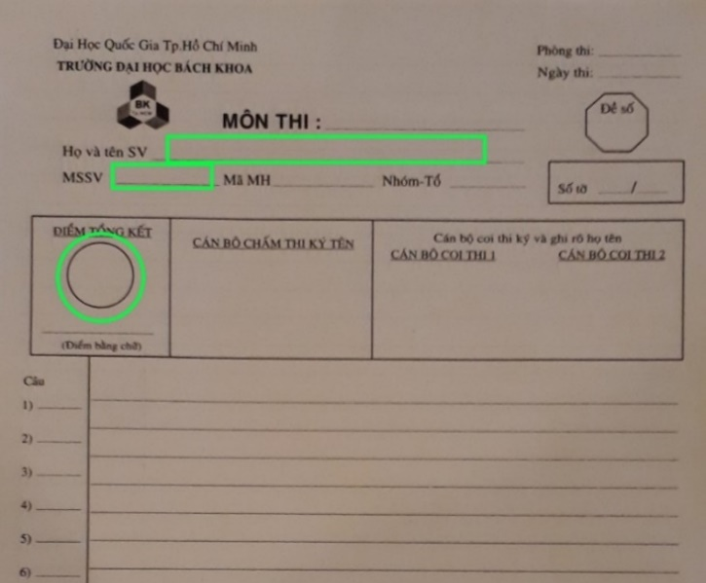
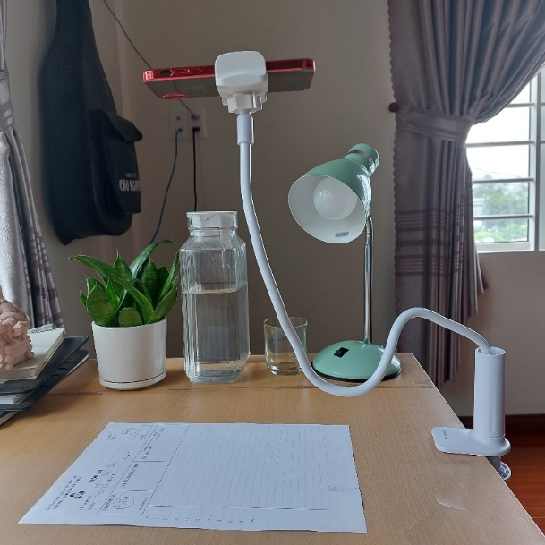
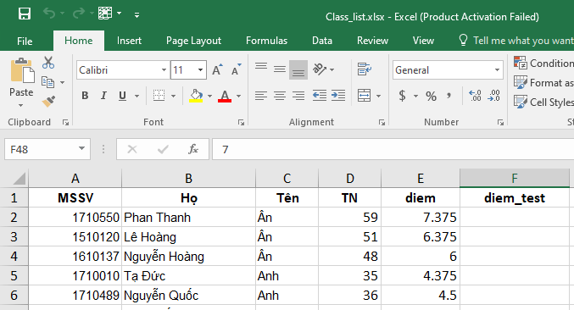
Objectives
Step 1
Step 2
Step 3
After the grading phase, teacher puts the test paper under the camera
Extract and recognize information name, studentID, score
Update score into Excel

Slide 6
02
BACKGROUND PRINCIPLES

Slide 7
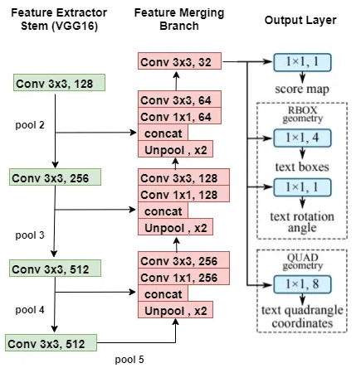

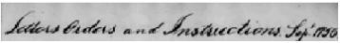

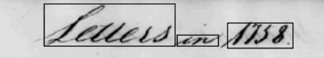
Text Dextection
Line Segmentation
Blob like feature
Word Segmentation
EAST Detector
Scale Space Technique

Slide 8
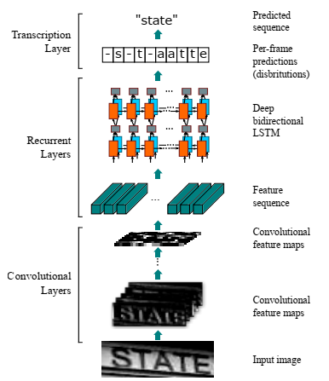
Text Recognition
CRNN associated with CTC Loss
CNN: Extract image features
RNN: Predict characters from Feature Vector
Transcription Layers: Predict output from Per-frame predictions
Model CRNN

Slide 9
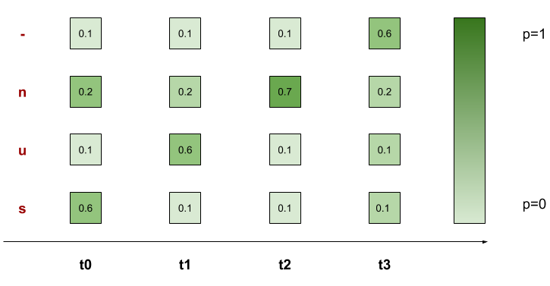
CTC Loss Function
Correct Alignments of Ground Truth “sun”:
-sun, s-un, su-n, sun-, suun, ssun, sunn
Advantages
Encode
Decode
p('sun') = ?
Notes:
Tới đây là tổng hết 5ph

Slide 10
03
RESULTS

Slide 11
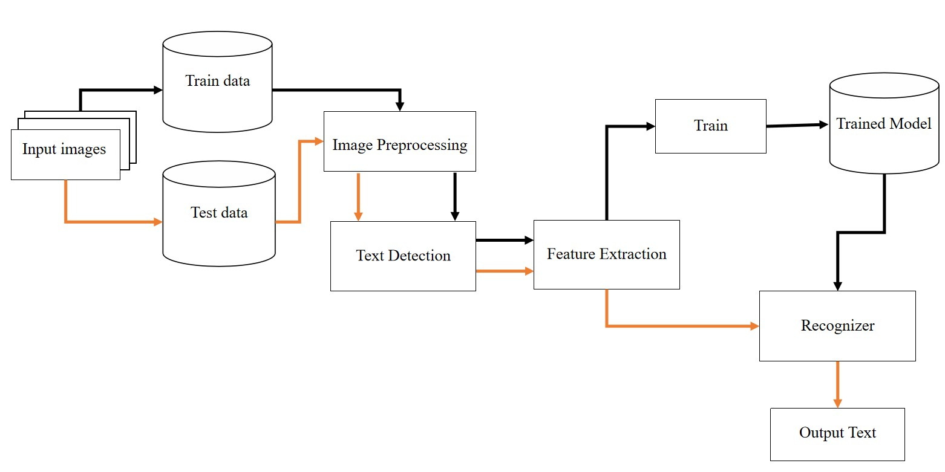
Flow Chart of Training and Recognizing Handwritten Text

Slide 12
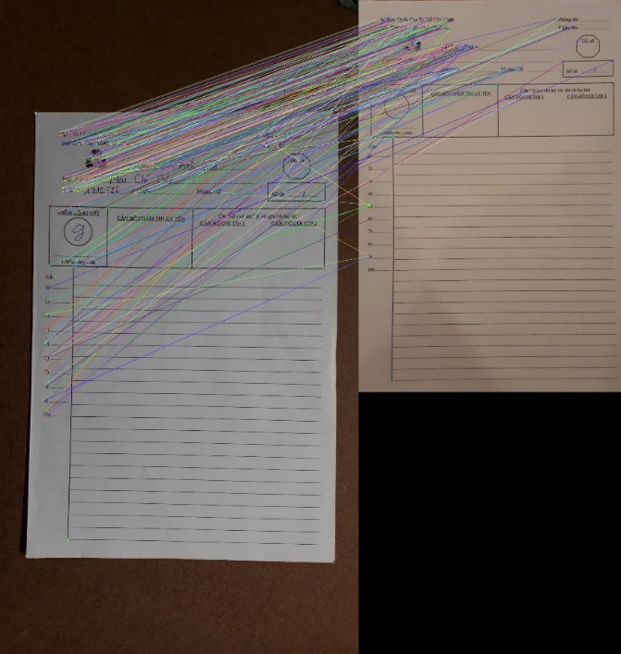
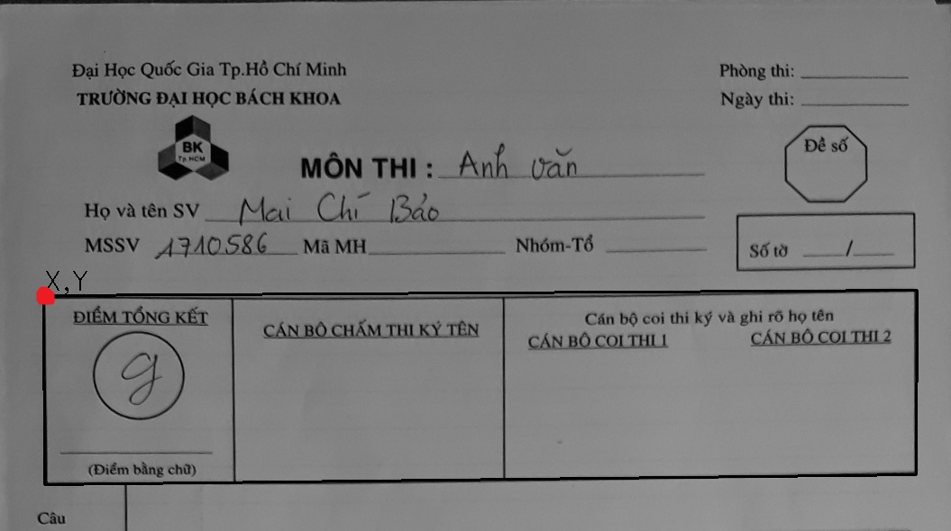

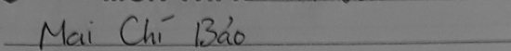
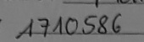
Image Preprocessing
Idetify the biggest box and other information
Image Alignment Technique
Notes:
KT Image Align, Ảnh xám, Cắt khung điểm

Slide 13
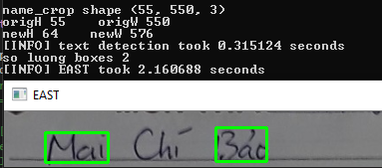
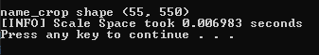
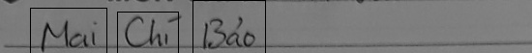
EAST & Scale Space Comparison
EAST
Scale Space
Slower
Complex
Require stronger laptop
Have to resize the original image
Faster
Simple
Suitable with the system

Slide 14
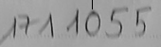
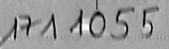
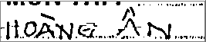
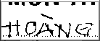
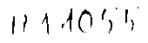
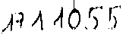
Image Preprocessing
Adaptive Threshold
OTSU Threshold
Contrast Increasing with Top Hat and Black Hat transform

Slide 15
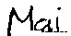
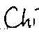
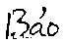
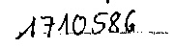

Image Preprocessing
Name:
Student ID:
Score:

Slide 16
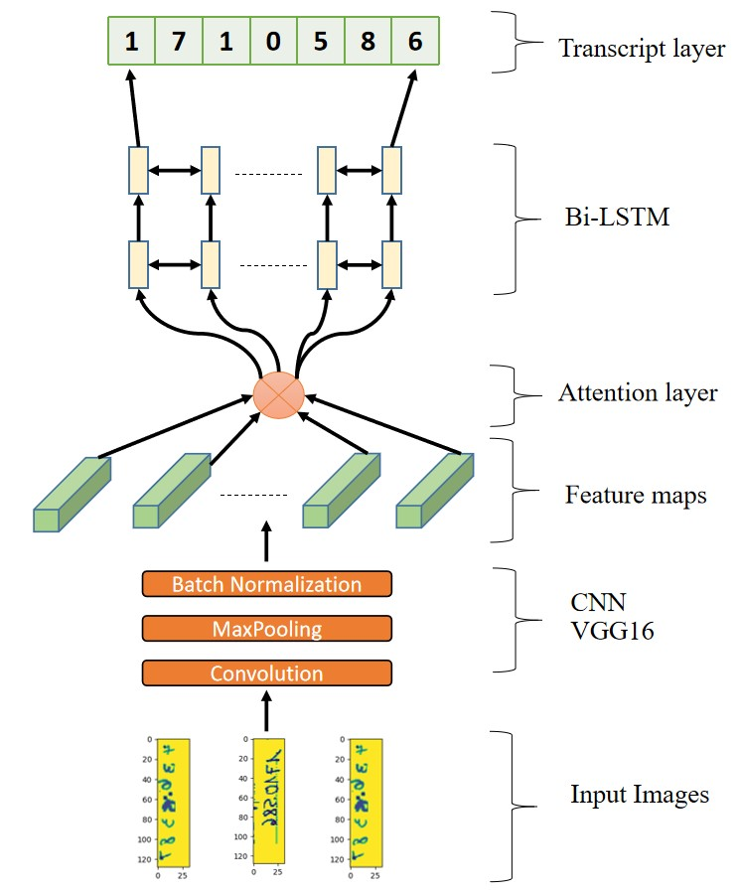
Model Structure
Training Phase
Data Augmentation
Changing Learning Rate
Early Stopping
Model Structure
Notes:
Dùng 2 model, Giải thích model

Slide 17

Evaluation on 122 Images dataset
Icluding 122 test images of “Mai Chí Bảo 1710586” with diffenrent:
Backgrounds
Camera angles
Lighting
➔ To evaluate the preprocessing and “Name_Student ID” recognition performance
Sample of 122 images dataset

Slide 18
Evaluation on 122 Images dataset
 | 7-digit number and blob noise | + Combination of 1,3,4,5,7- digit number | + Rotate, scale, Random Cutout, Line Noise on digit images | + Changing the distance between digits. Scale, Rotate on multi-digit images | + Adding real data (799 images) | + Lexicon Search
CER | 63.82% | 48.24% | 45.55% | 13.58% | 3.63% | 2.58%
WER | 100.00% | 100.00% | 100.00% | 63.11% | 22.95% | 13.11%
 | CRNN + CTC | + Data Augmentation | + Changing Learning Rate | + Attention | + Lexicon search
CER | 35.25% | 23.40% | 16.77% | 16.24% | 0.45%
WER | 74.59% | 69.40% | 45.63% | 47.27% | 0.55%
Result of Name recognition on 122 images dataset
Result of Student ID recognition on 122 images dataset
Notes:
Giải thích CER, WER, lexicon 245, 3 cái đầu nói ngắn gọn,

Slide 19
Evaluation on 122 Images dataset
“Mai Chí Bảo 1710586”
CER, WER = 0%

Slide 20

Evaluation on 100 Unconstrained Images dataset
Unconstrained factors:
Font type, font size, spacing
Backgrounds, camera angles, lighting
➔ To evaluate the accuracy of name, student ID, score recognition when operates under bad conditions
Sample of 100 unconstrained images dataset

Slide 21
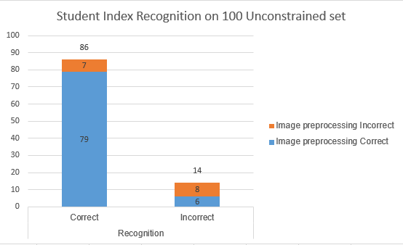
Evaluation on 100 Unconstrained Images dataset “Name_Student ID”
Image Preprocessing correct 85%.
Return the right index 86%.
Correct recognition of 92.94% index on correct preprocessed images.
Result of student index recognition
on 100 unconstrained images dataset
Notes:
haha

Slide 22
Evaluation on 100 Unconstrained Images dataset “Name_Student ID”
No font type in data train
Common mistakes:
Wrong Word Segmentation
“Nguyễn Đức Hoàng 1711393” & “Nguyễn Đắc Hoàng 1711392”

Slide 23
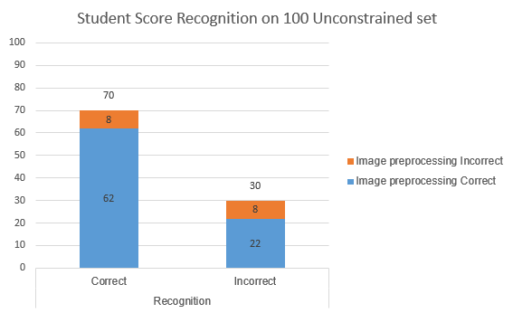
Evaluation on 100 Unconstrained Images dataset “Score”
Image Preprocessing correct 84%.
Return the right score 70%.
Correct recognition of 73.81% score on correct preprocessed images.
Result of student score
on 100 unconstrained images dataset

Slide 24
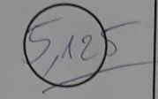
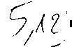
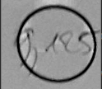

Evaluation on 100 Unconstrained Images dataset “Score”
Score beyond the limit circle
Blurred images leads to information lost

Slide 25
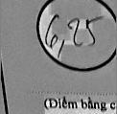

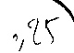
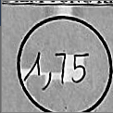

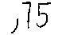
Evaluation on 100 Unconstrained Images dataset “Score”
Incorrect Image crop
Contour drawing error

Slide 26
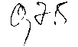
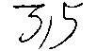

Evaluation on 100 Unconstrained Images dataset “Score”
The comma “,” makes 0 like 9
The digit 3 with horizontal strokes is not in the training set
The digit 5 is very badly written

Slide 27

Evaluation on 103 Constrained Images dataset
Constrained factors:
Font type, font size, spacing
Backgrounds, camera angles, lighting
➔ To evaluate the accuracy of name, student ID, score recognition without errors from the users
Sample of 103 constrained images dataset

Slide 28
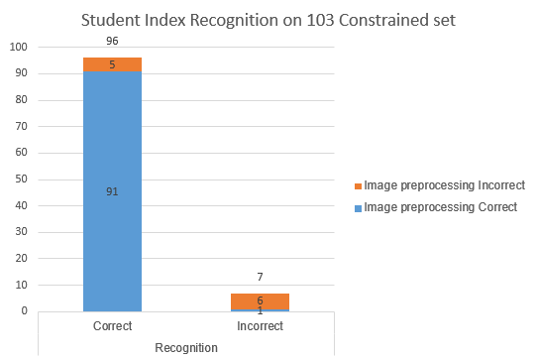
Evaluation on 103 Constrained Images dataset “Name_Student ID”
Image Preprocessing correct 89.3% increase by 4.3%
Return the right index 93.2% increase by 7.2%
Correct recognition of 98.91% index on correct preprocessed images increase by 5.97%
Result of student index recognition
on 103 constrained images dataset
Result of student index recognition
on 100 unconstrained images dataset

Slide 29
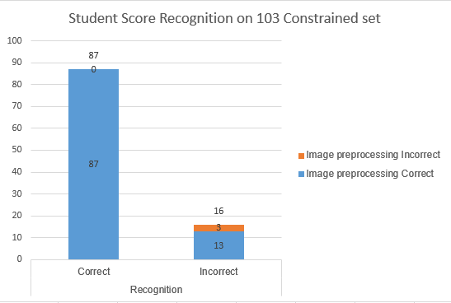
Evaluation on 103 Constrained Images dataset “Score”
Image Preprocessing correct 97.09% increase by 13.09%
Return the right score 84.47% increase by 14.47%
Correct recognition of 87% score on correct preprocessed images increase by 13.19%.
Result of student score
on 103 constrained images dataset
Result of student score
on 100 unconstrained images dataset
Notes:
Tới đây là hết 13ph

Slide 30
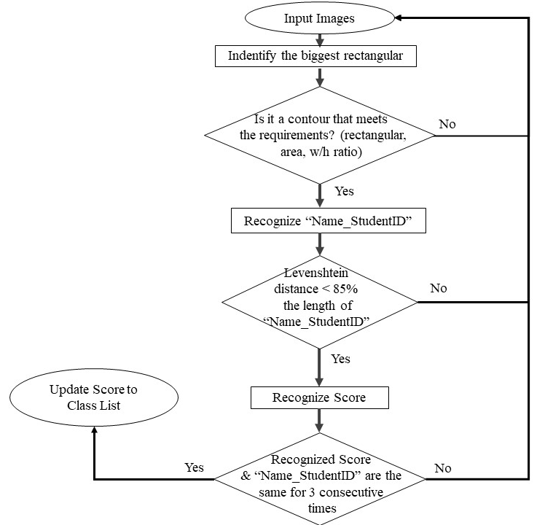
Evaluation on Video
Score entry accuracy is 95.55% (43/45 test papers correctly updated)

Slide 31
04
CONCLUSIONS

Slide 32
Future Works
01
Changing training dataset into images with background instead of threshold image
02
Connect with online transcripts
03
Optimize the algorithm

Slide 33
Thanks for your listening!

